Slide 1
Schedule
Day 1: AI Essentials
AI History, Significance, Philosophy, Various Branches
Machine Learning Fundamentals (supervised, unsupervised, and reinforcement learning)
Deep Learning Fundamentals
Day 2: Generative AI and LLM(s)
Generative AI vs Discriminatory AI
Generative models (GANs and VAEs)
Transformers and LLMs
Day 3: Prompt Engineering, Future Trends, and Ethics
Text, video, audio, image generation
Where is AI revolution heading to?
Is the future with AI safe?

Slide 2
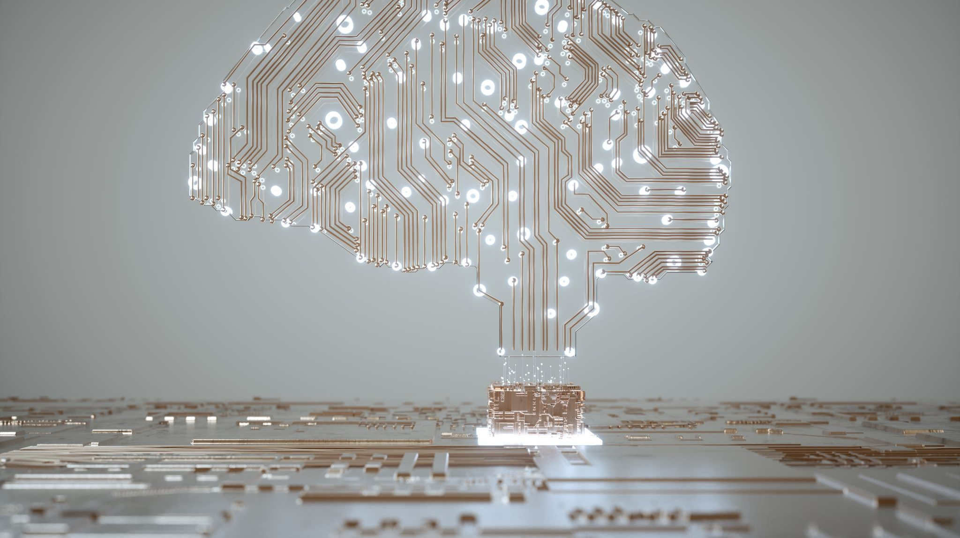
AI Essentials
Day 1

Slide 3
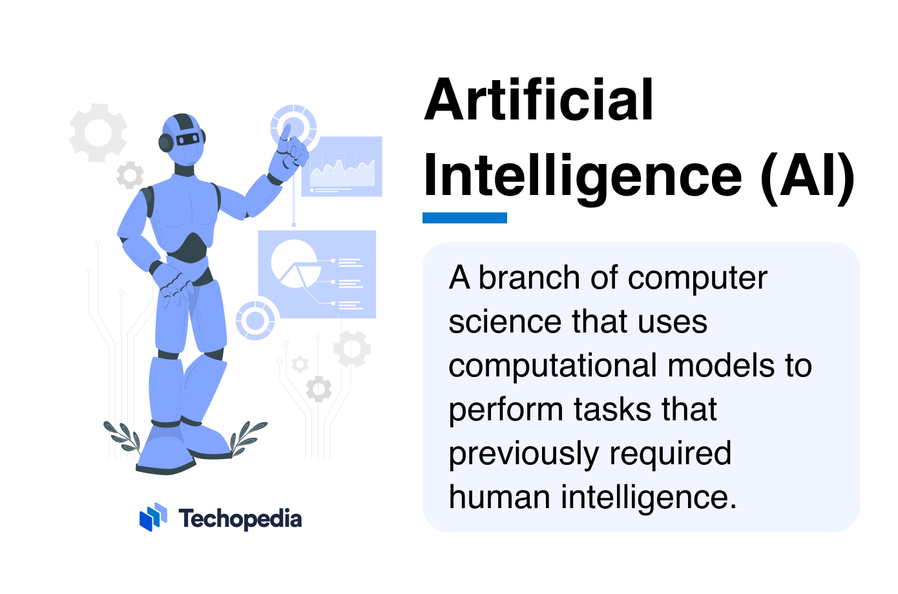
Notes:
https://www.techopedia.com/definition/190/artificial-intelligence-ai

Slide 4

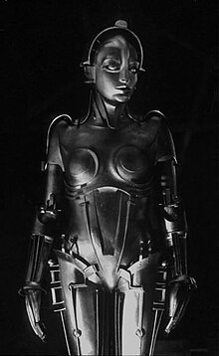
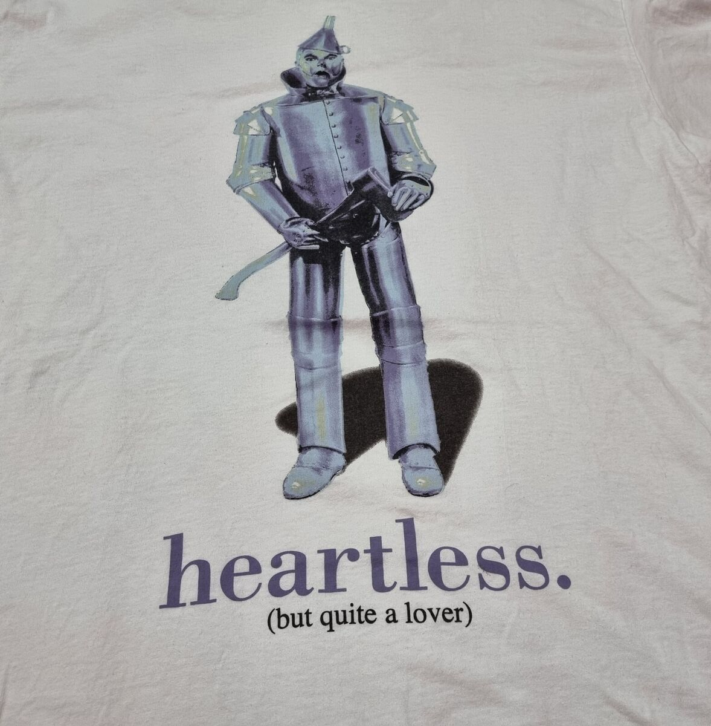
Early Fictional Thoughts on Artificial Intelligence

Slide 5
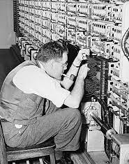
Can Machines Think?
Imitation game” by Alan Turing
Theological Objection – thinking belongs to humans
“Heads in the Sand” Objection – too disturbing
Mathematical Objection – proofs
Lady Lovelace's Objection – machines can learn
Human
Machine
Interrogator
Objections to Machine Intelligence
Meaningless and ambiguous question
Argument from Consciousness – behavior
Arguments from Various Disabilities – imagination tasks
Argument from Continuity in Nervous System – discrete
Argument from Informality of Behavior – complex vs formal
Argument from Extra-Sensory Perception – telepathy
Chinese Room Argument

Slide 6

Fundamental Challenges by 1949
Limited Capabilities
computers couldn’t store commands, only execute them
instructed on what to do but couldn’t retain a record of their actions
ENIAC (Electronic Numerical Integrator and Computer)
High Costs
ENIAC – “Giant Brain”: 487,000 (7m)
Monthly Leasing: $200,000

Slide 7
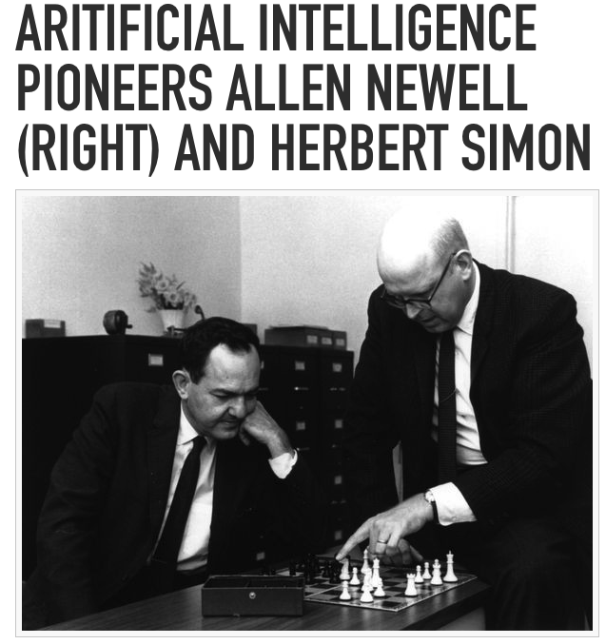
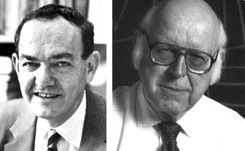
Logic Theorist: First Artificial Intelligence Program in 1955-1956

Slide 8
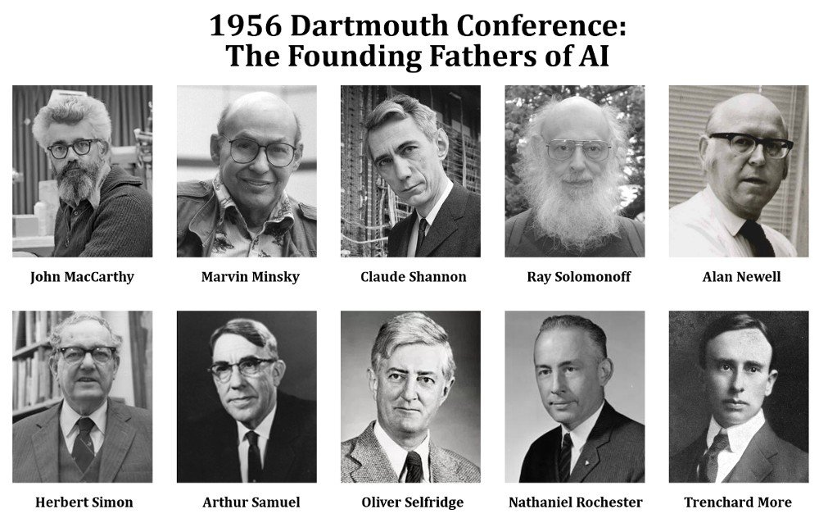

Slide 9
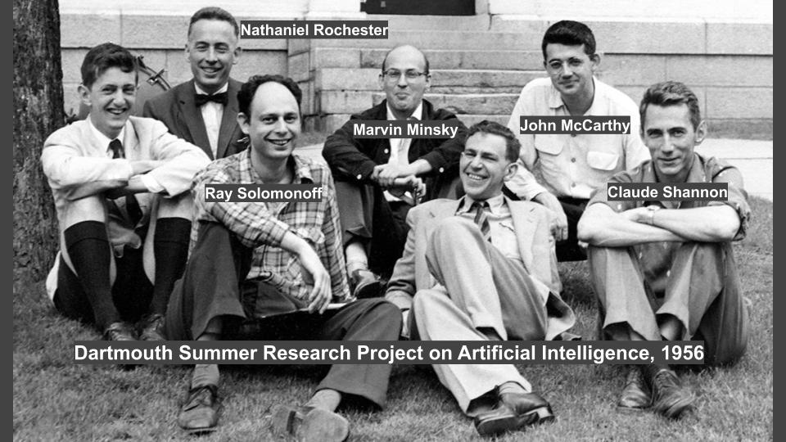

Slide 10
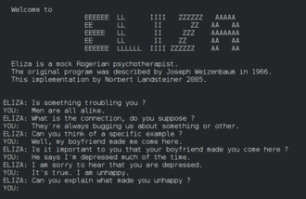
AI Boom in 1957-1973
Increased Storage and Speed and Cost Reduction
General Problem Solver in 1957-1959 by Newell, Simon, and Shaw
ELIZA from 1964 to 1967 at MIT by Joseph Weizenbaum.

Slide 11
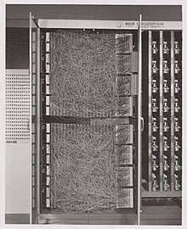
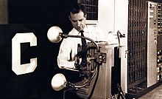
Developments on Deep Learning Front and Fall of Neural Networks
First hardware implementation of Perceptron : McCulloch–Pitts neuron
Mark I Perceptron machine
Early Ideas on Backpropagation
introduced in 1962 by Frank Rosenblatt
"Perceptrons” by Marvin Minsky and Seymour Papert

Slide 12
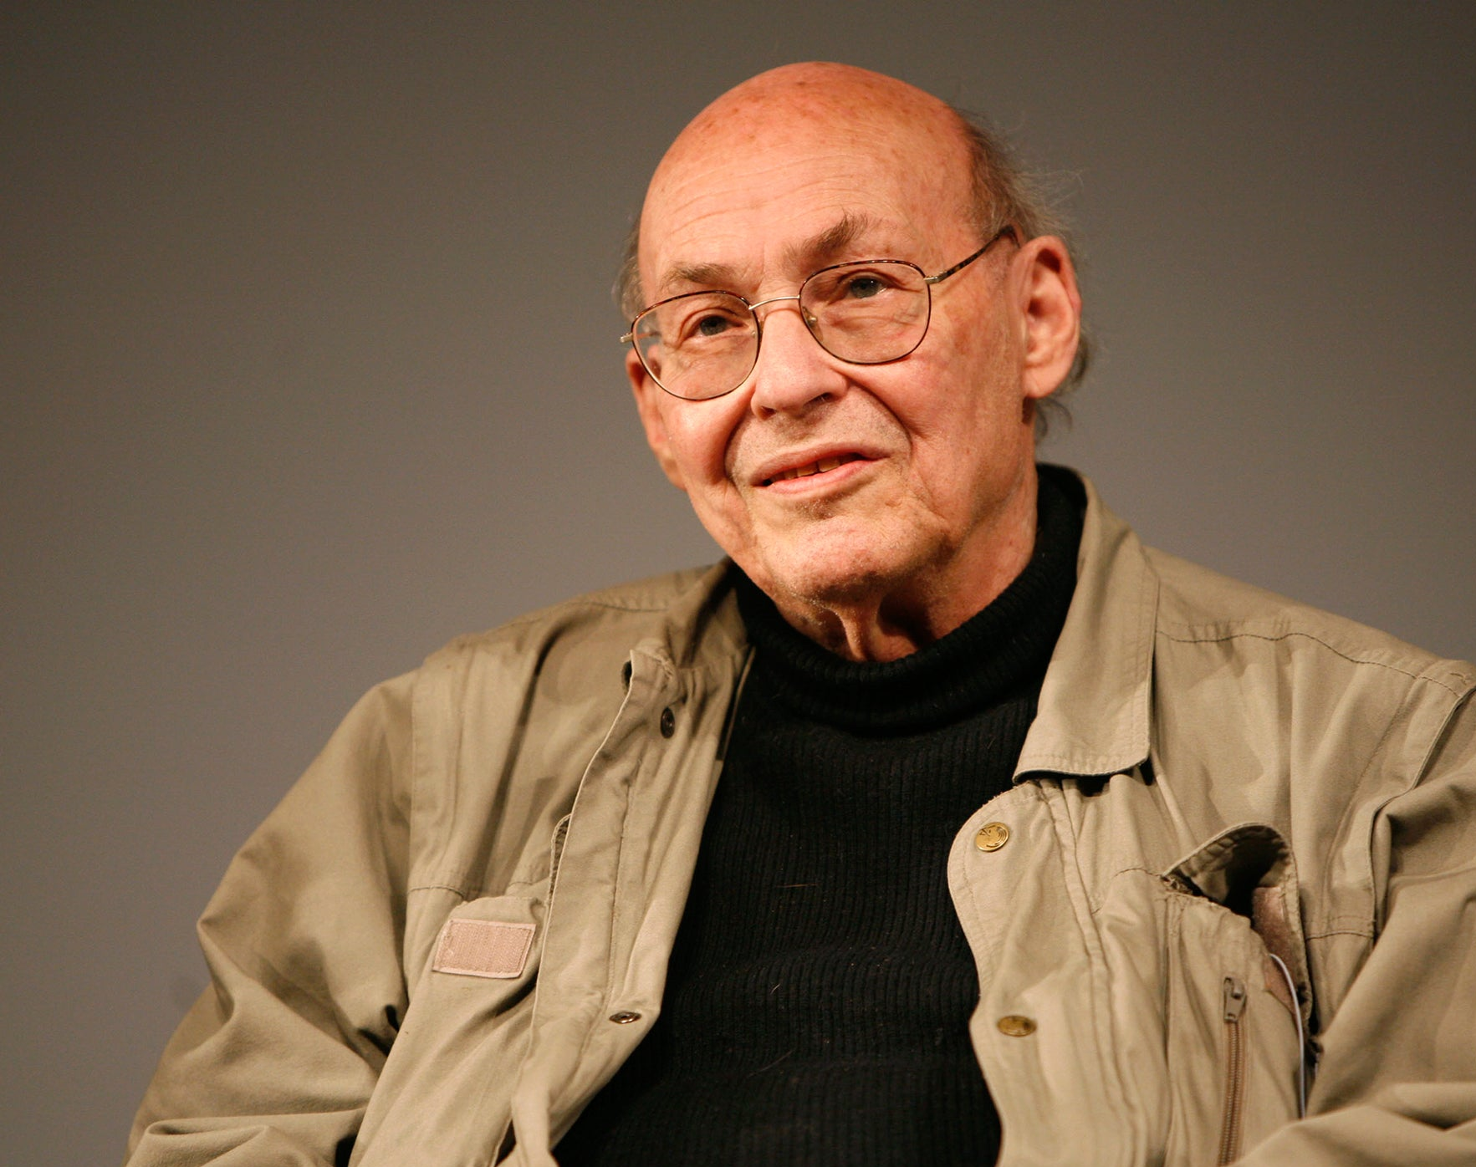
“From three to eight years we will have a machine with the general intelligence of an average human being.” AI pioneer Marvin Minsky in 1970
'The world has lost one of its greatest minds in science'

Slide 13
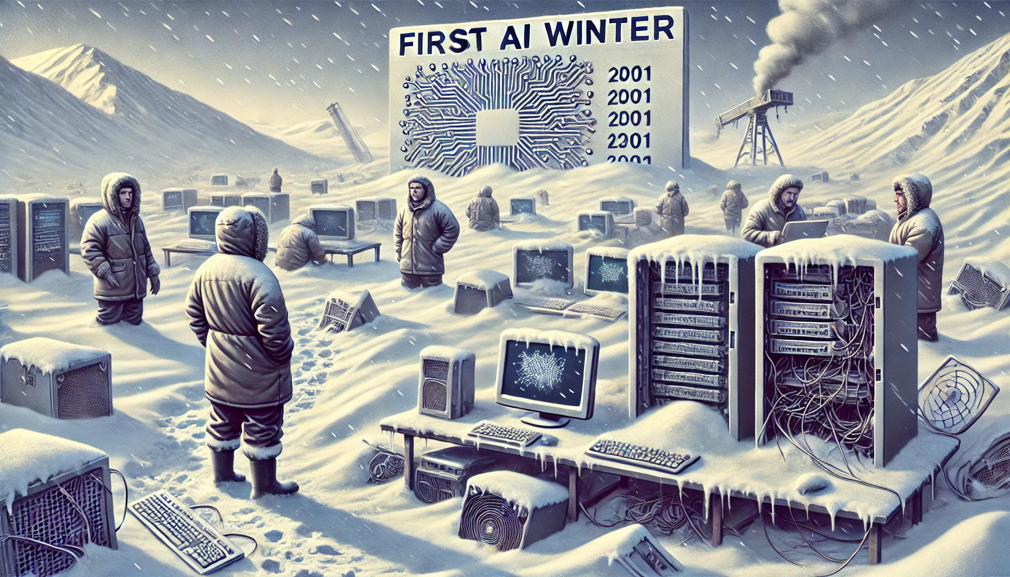
First Winter: 1974-1980
Characterized by Low AI funding and Declined AI Research
Many unfulfilled promises
Overconfidence based on simple examples
Failure on broader or more difficult tasks
Translation English
ALPAC report on machine translation
DARPA cuts funding
Lighthill Report for British Science Research Council
Two Fundamental Problems
Fall of Neural Nets Perceptrons (1969) - Book
Memory and processing speed

Slide 14

“In no part of the field have the discoveries made so far produced the major impact that was then promised”
Lighthill Report

Slide 15
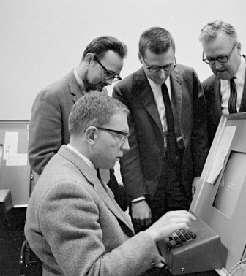
Resurgence of AI in 1980s
Expansion of algorithmic toolkit
Rising funds
Second generation Expert-Systems
Rule-Based Systems/Knowledge-Based Systems
Edward Feigenbaum- “Father of Expert Systems”
DENDRAL (1965) and MYCIN (early 1970s) at Sandford University
XCON at Carnegie-Mellon University
Commercialization of AI technology
Advances in Deep Learning

Slide 16
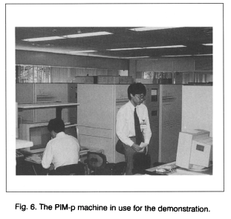
Fifth Generation Computer Systems (FGCS)
Developed to Solve Previous Problems
Brought New Advantages
concurrent logic programming
massively parallel computing
innovative computer architectures
Knowledge Processing
But commercially failed
Legacy in parallel computing technologies

Slide 17
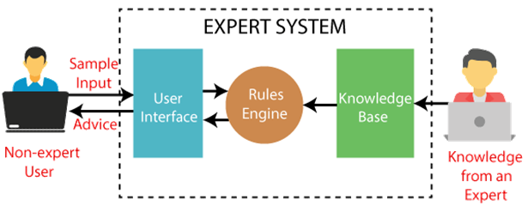

Slide 18
Developments on Deep Learning Front
Return of Neural Networks
John Hopfield and David Rumelhart popularized “deep learning”
Backpropagation
In 1989, Yann LeCun provided first practical demonstration of backpropagation at Bell Labs – towards CNNs (second winter had already started)
"Learning Representations by Back-propagating Errors"

Slide 19
Second Winter 1987-1994
Limitations of If-then reasoning
Market for Lisp machines collapses
DARPA cuts funding
Expert Systems fail to replicate human reasoning
Fifth Generation Computer failed in conversations, image interpretation, and humanlike reasoning
Desktop computers

Slide 20
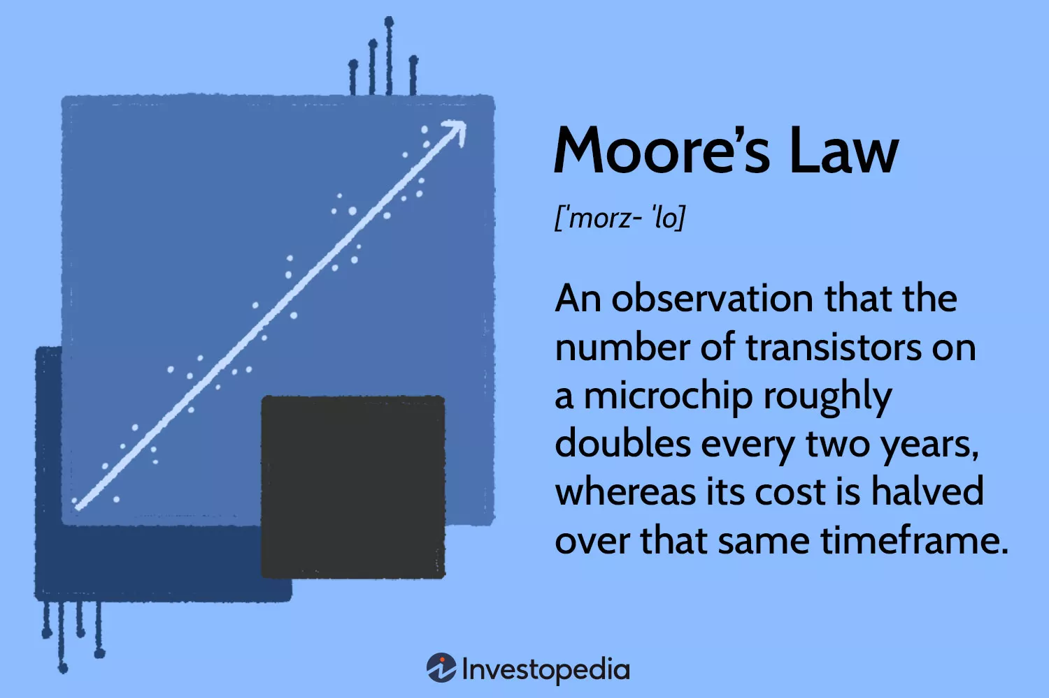
Revival of AI in Late 1990s
1997: world chess champion and grand master Gary Kasparov was defeated by IBM’s Deep Blue
1997: speech recognition software, developed by Dragon Systems, was implemented on Windows
1998: LeNet-5 CNNs Architecture
Moore’s Law had finally caught up

Slide 21
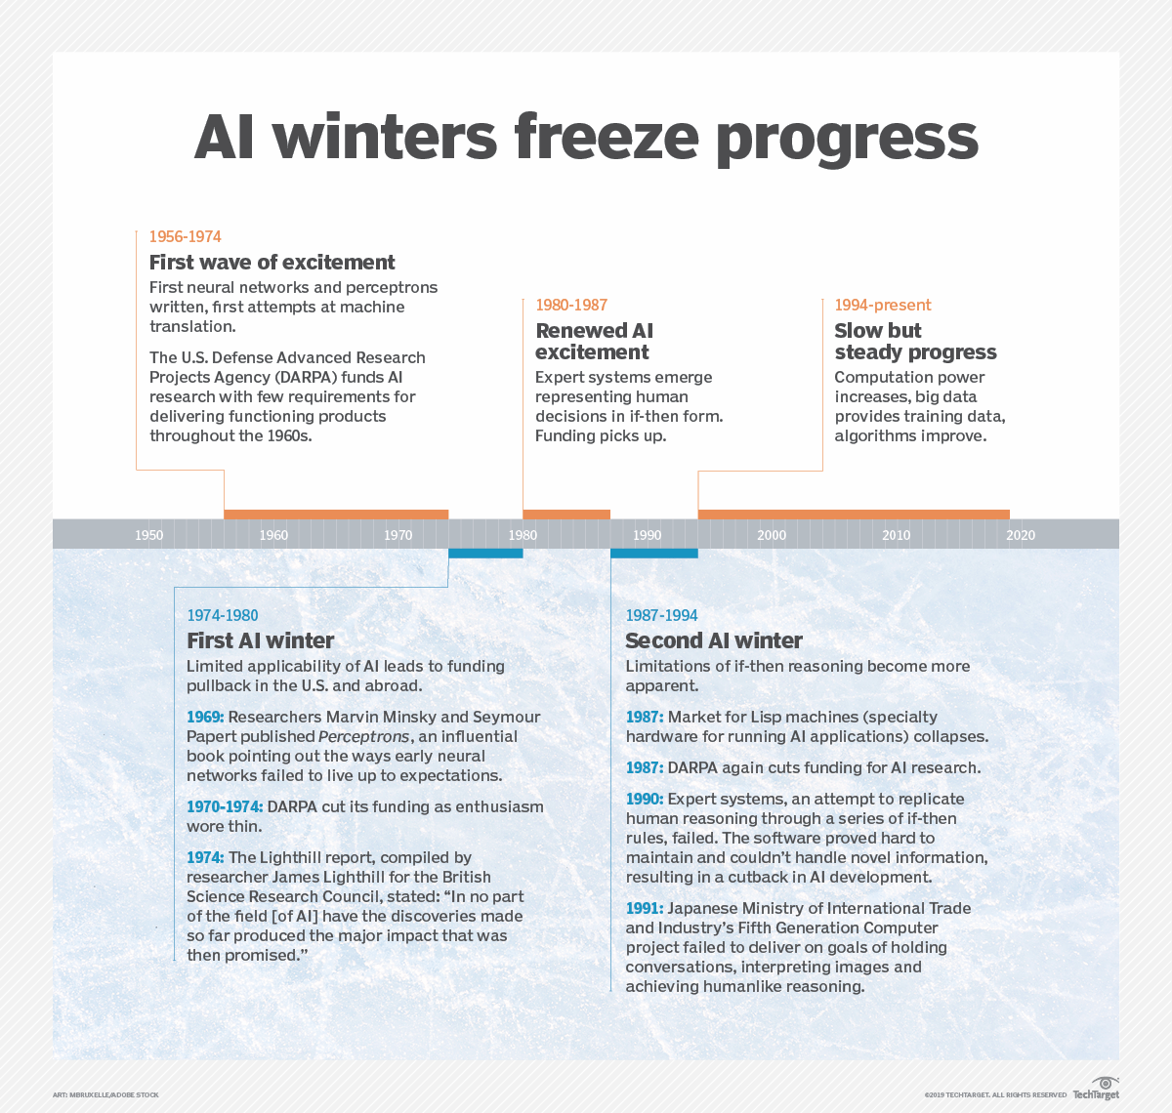
Notes:
https://www.techtarget.com/searchenterpriseai/definition/AI-winter

Slide 22
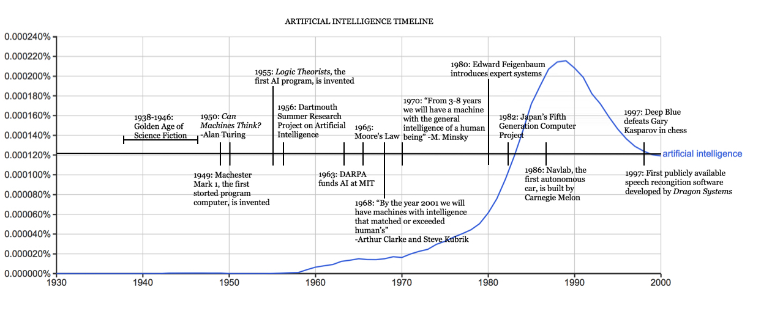
Notes:
https://sitn.hms.harvard.edu/flash/2017/history-artificial-intelligence/

Slide 23
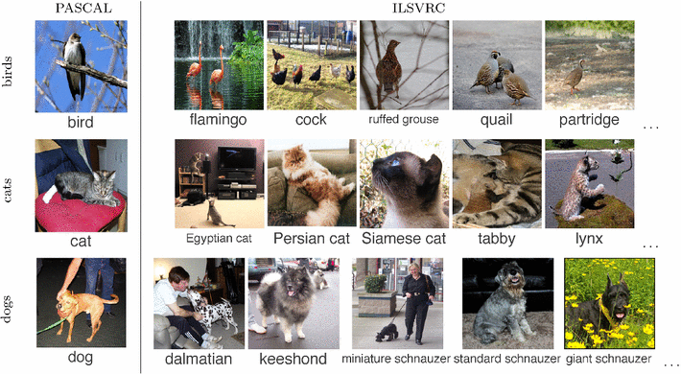
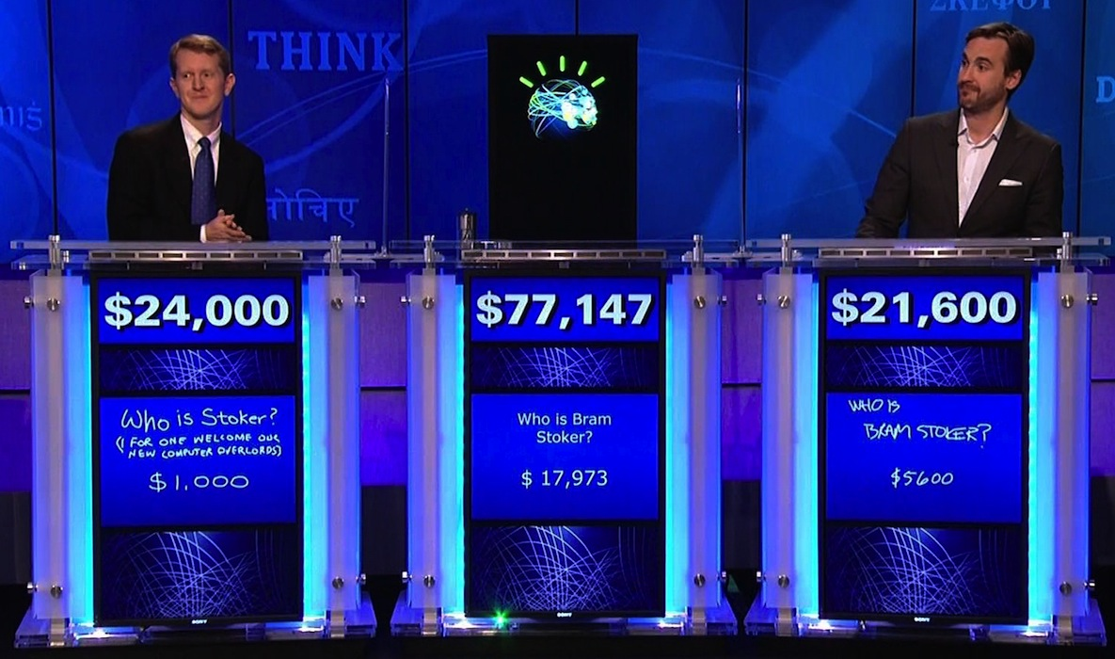
The Rise of Deep Learning in 2000 and early 2010s
Computer Vision
ImageNet Large Scale Visual Recognition Challenge (ILSVRC)
AlexNet
Virtual Assistants
Siri and Alexa
Natural Language Processing
IBM Watson in Jeopardy!

Slide 24
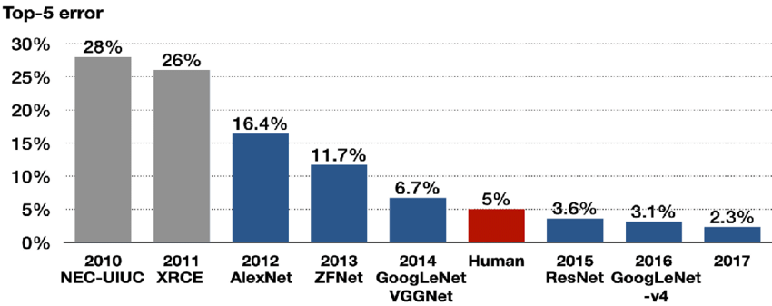
Algorithms that won ImageNet Large Scale Visual Recognition Challenge (ILSVRC) in 2010-2017

Slide 25
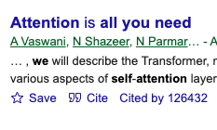

Transformer Architecture
Technical details on the second day!

Slide 26
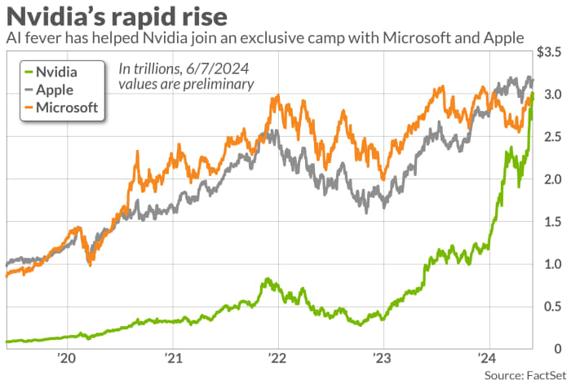
All Become Possible with Advances in GPU…

Slide 27
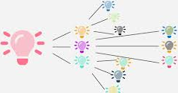
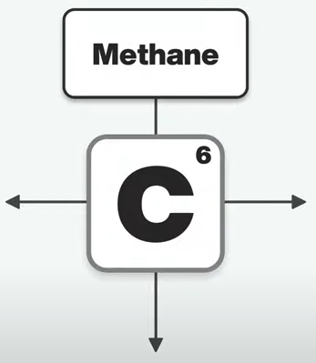
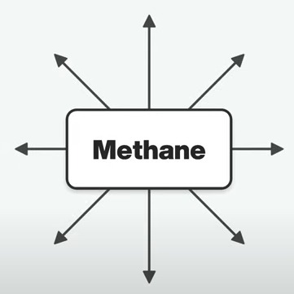
Adjacent Possible
Any given moment, potential for innovation and evolution is limited to immediate next steps that are achievable from current state.
AI evolves incrementally by building on existing technologies and knowledge.
Limited Computation for Imitation Game
Herbert Simon: within 10 years a computer would be a chess champion and a machine would prove a significant mathematical theorem.
Transformers
Hardware Advances: GPUs and TPUs

Slide 28
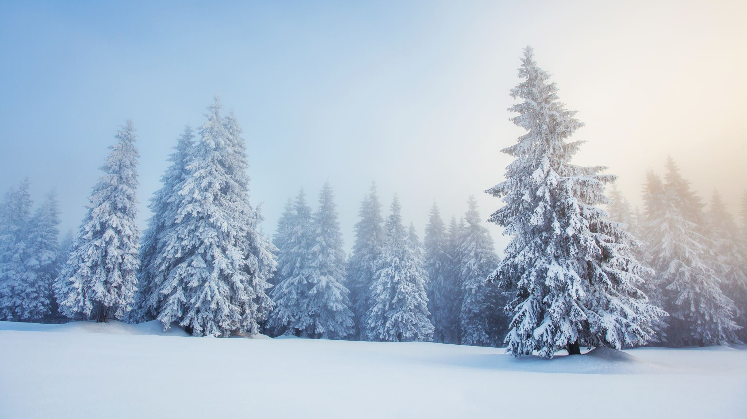
Will There Be Another Winter? We will Discuss it on Day 3!

Slide 29
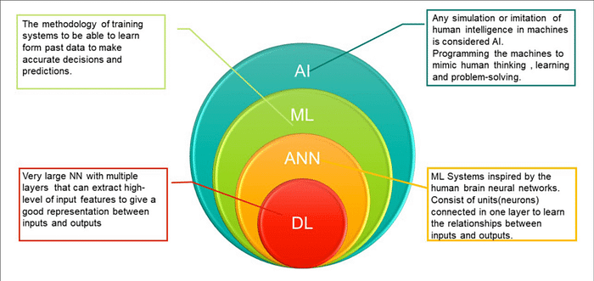
Notes:
https://medium.com/@pavanece496/fundamentals-of-machine-learning-a-comprehensive-introduction-3b9d2ddbd602

Slide 30
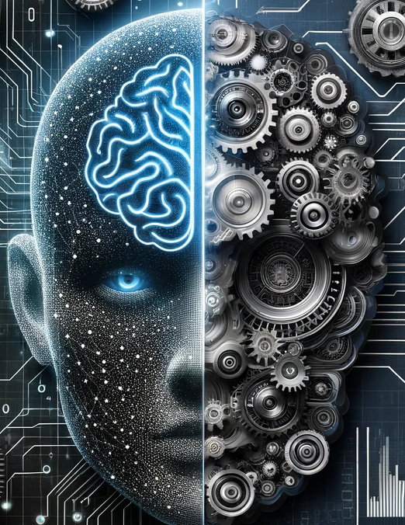
What is Machine Learning?
Rule-based system
Expert-driven system
If-then rules to make decisions and perform tasks
Give loan if income >50,000
credit card fraud if geographic anomaly
anomaly-based detection rules in cyber security
signature-based detection rules in cyber security
Downside: new threats, fraud tactics etc.
Machine learning
Automatically learn and improve from experience without being explicitly programmed
Data-driven approach
Downside: lack of data- simulation data scientist

Slide 31
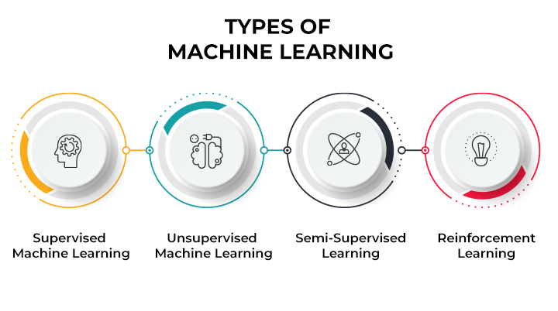

Slide 32
Supervised Learning Intuition
Var1 | Var2 | Var3 | Var4 | Var5 | Var6 | Var7 | Var8 | Var9 | class
94.99 | 105.35 | 10.56 | 10.45 | 105.46 | 106.34 | 107.39 | 109.22 | 101.22 | 1
9.55 | 10.35 | 100.56 | 100.45 | 10.55 | 55.49 | 10.21 | 10.44 | 10.25 | 0
9.77 | 10.35 | 100.56 | 100.45 | 10.46 | 10.34 | 10.39 | 10.22 | 10.22 | 0
94.96 | 105.35 | 10.56 | 10.45 | 105.46 | 106.34 | 107.39 | 109.22 | 101.22 | 1
94.98 | 105.35 | 10.56 | 10.45 | 105.46 | 106.34 | 107.39 | 109.22 | 101.22 | 1
9.90 | 10.35 | 103.56 | 104.45 | 10.46 | 10.34 | 10.39 | 10.22 | 10.22 | 0
94.99 | 105.35 | 10.56 | 10.45 | 105.46 | 106.34 | 107.39 | 109.22 | 101.22 | 1
Var1 | Var2 | Var3 | Var4 | Var5 | Var6 | Var7 | Var8 | Var9 | class
99.90 | 106.50 | 9.88 | 10.43 | 102.42 | 107.35 | 109.55 | 107.47 | 109.22 | ??
8.55 | 10.39 | 101.50 | 102.52 | 11.57 | 53.96 | 12.45 | 9.42 | 14.01 | ??

Slide 33
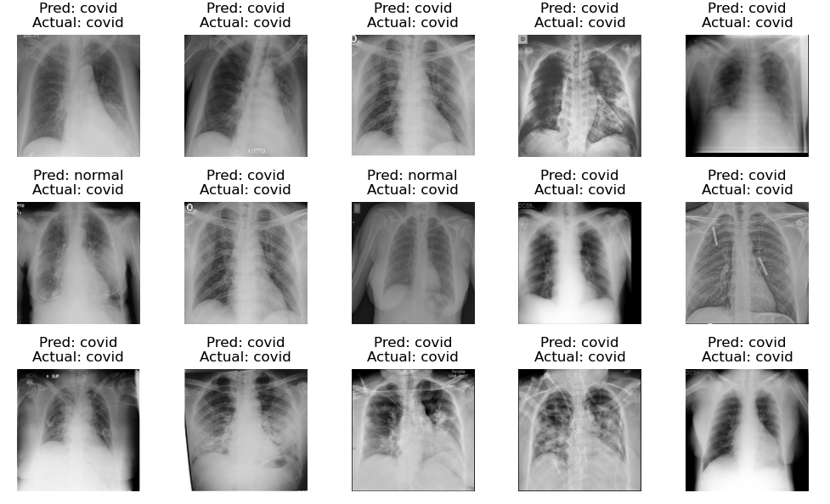

Slide 34
Supervised ML Tasks
Regression
Predicts a continuous outcome. For instance: house price predicted by number of bedrooms, area, location
Classification
Assigns a label from a predefined set to an instance. For instance: is an email spam or ham(not spam).
Computer vision
Associating images with labels. For instance: is an image a cat, dog, or a bird.
Speech Recognition
Translating spoken language into text or executing voice commands.

Slide 35
Unsupervised Learning
No labels
Primary tasks
clusters: K-means
associations: Apriori
dimensionality reduction: PCA
Complexity
unpredictable results
No one true answer: more interpretation
Domain knowledge

Slide 36
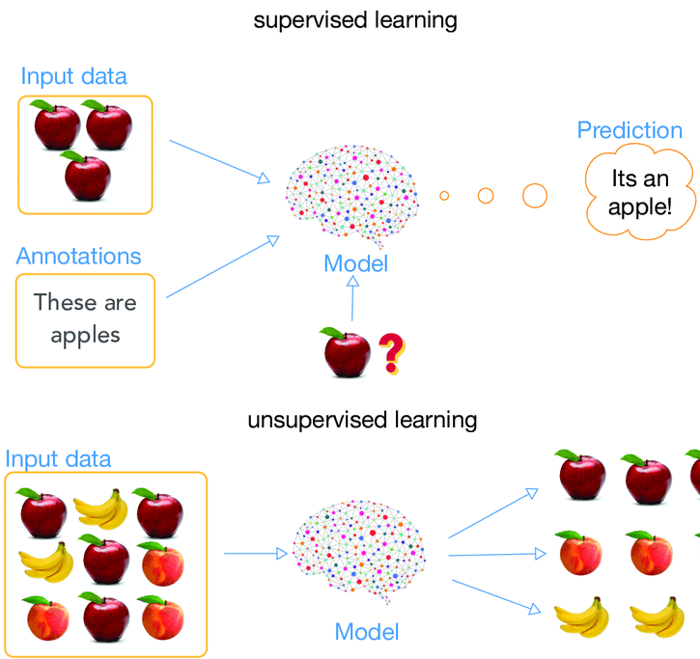
Supervised Learning vs Unsupervised

Slide 37
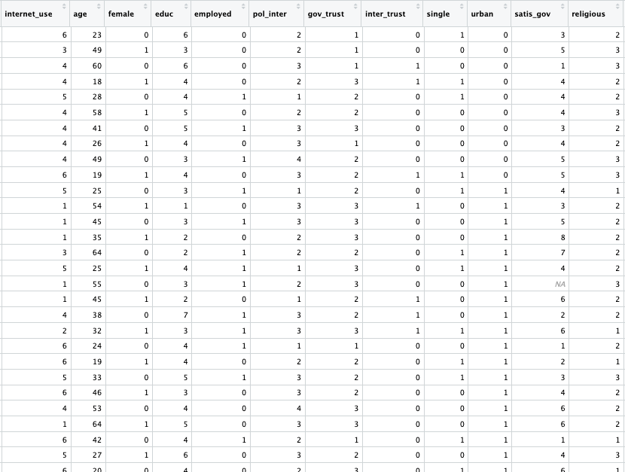
Unsupervised Example

Slide 38
Unsupervised Learning: Text Classification vs. Topic Modeling
Text Classification
1 | Stocks Sink as Stubborn Inflation Resets. | Business
2 | Biden Denounces Trump’s Support for Russian Attack on Allies as ‘Un-American’ | Politics
3 | This Arctic Circle Town Expected a Green Energy Boom | Climate Change
 | Topic Modeling
1 | I love driving my car on the open road
2 | The engine of my vehicle is very powerful
3 | Libraries have thousands of books to read
4 | Reading a good book is a joy
5 | Cooking fresh meals is therapeutic
6 | A kitchen is a place where meals are made
Topic 1: {car, driving, engine, vehicle, road}
Topic 2: {libraries, books, read, joy}
Topic 3: {cooking, meals, therapeutic, kitchen}

Slide 39
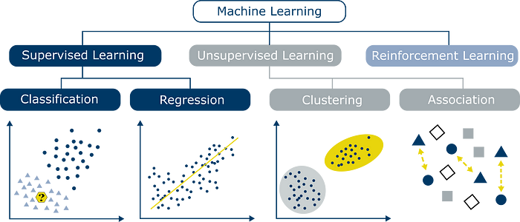

Slide 40
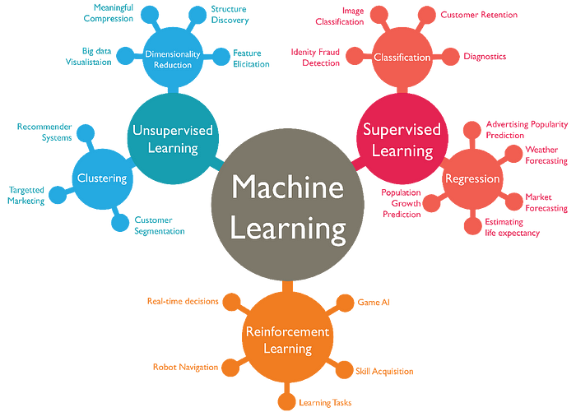

Slide 41
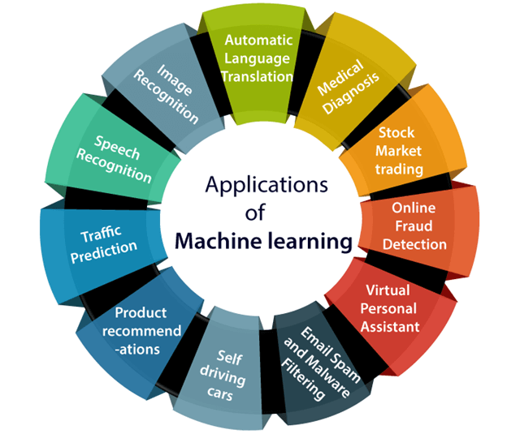
Notes:
https://medium.com/@pavanece496/fundamentals-of-machine-learning-a-comprehensive-introduction-3b9d2ddbd602

Slide 42
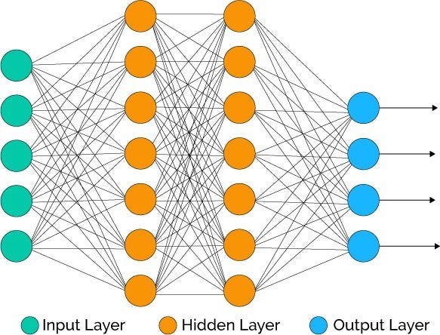
Deep Learning Fundamentals

Slide 43
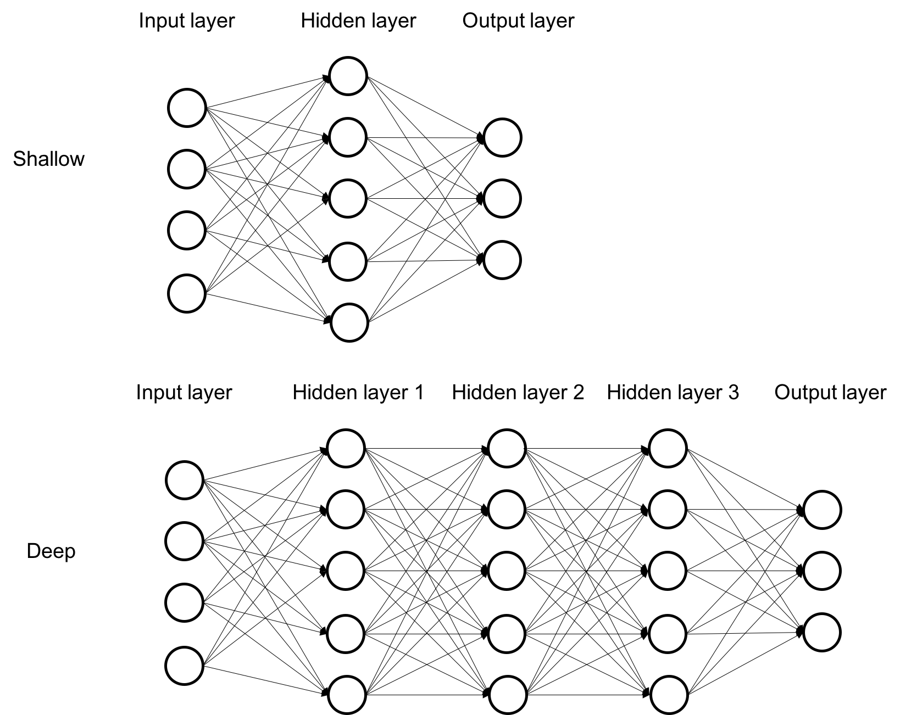
Deep Learning vs Shallow Learning

Slide 44
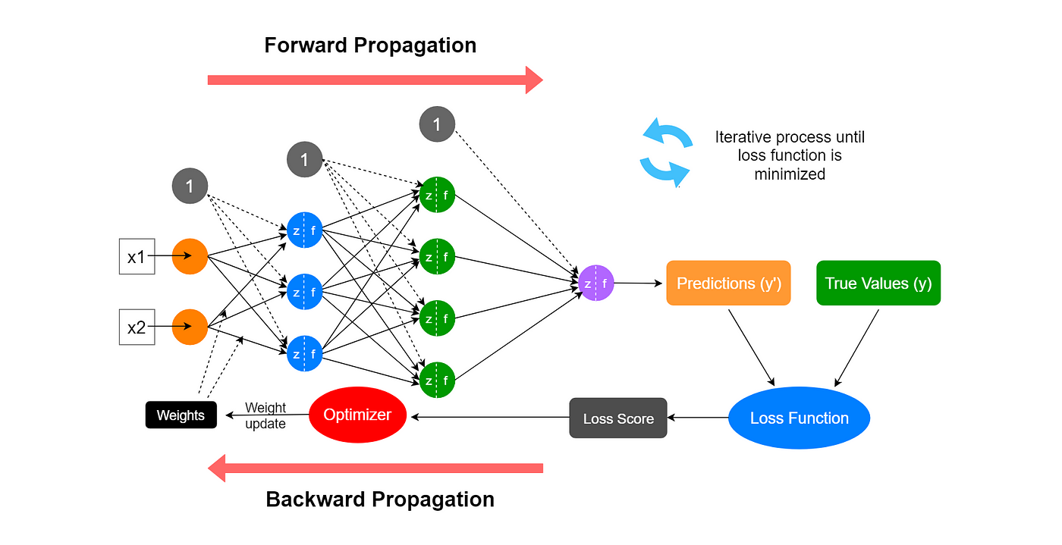

Slide 45
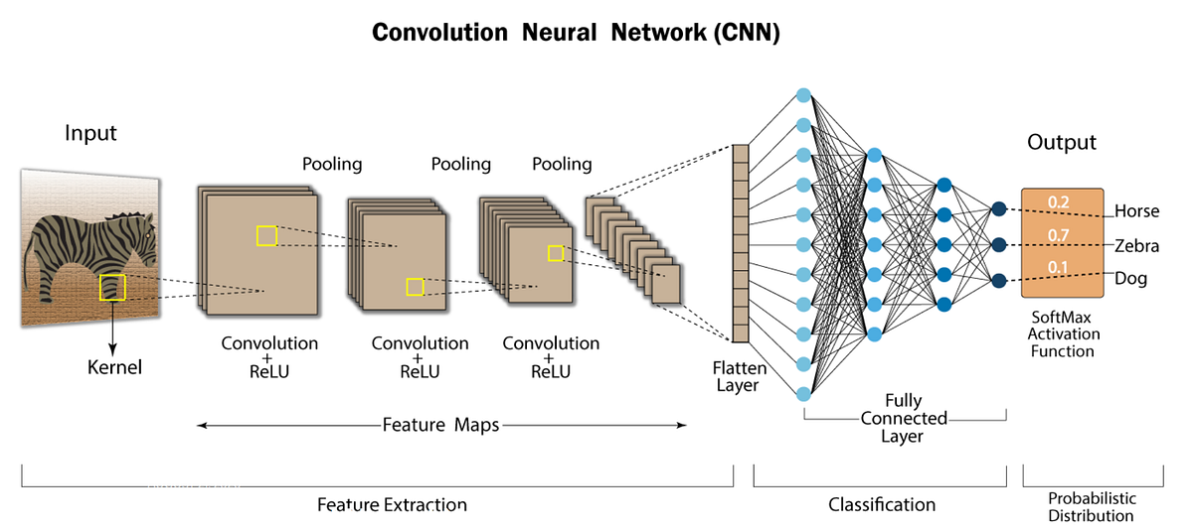
Notes:
https://stanford.edu/~shervine/teaching/cs-230/cheatsheet-convolutional-neural-networks

Slide 46
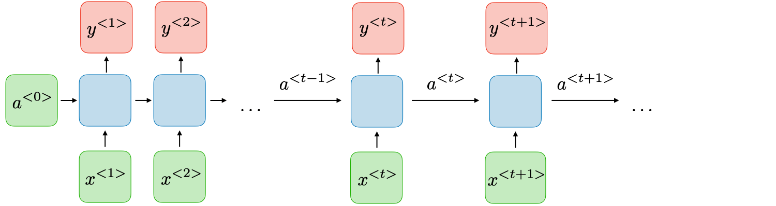
Recurrent Neural Networks(RNNs)

Slide 47

Thanks for Joining Us Today! See you tomorrow!

